Slide 1

Break Schedule App
Optimizing Employee Scheduling through Role-Based Access

Slide 2
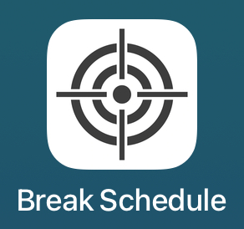
Project Overview
Mobile app for creating & managing employee break schedules
Built with SwiftUI + CloudKit backend
Role hierarchy: Store Director > ETL > TL > TM
Features: scheduling, swap requests, messaging, themes, pdf export

Slide 3
What I Learned
Academic/Intellectual:
CloudKit integration & real-time syncing
Role-based data filtering & permissions
Debugging save/fetch sync issues
Personal:
Patience with complex debugging
Confidence in iterative problem-solving
Balancing usability with technical depth
Career Relevance:
Prepares me for full-stack development roles
Real-world practice in database design & mobile UX

Slide 4
MVP
User authentication (Apple ID + username/password)
Create, edit, view break schedules
Role-based visibility & permissions
Swap request workflow (initiate → approve/deny → transfer)
CloudKit syncing across devices

Slide 5
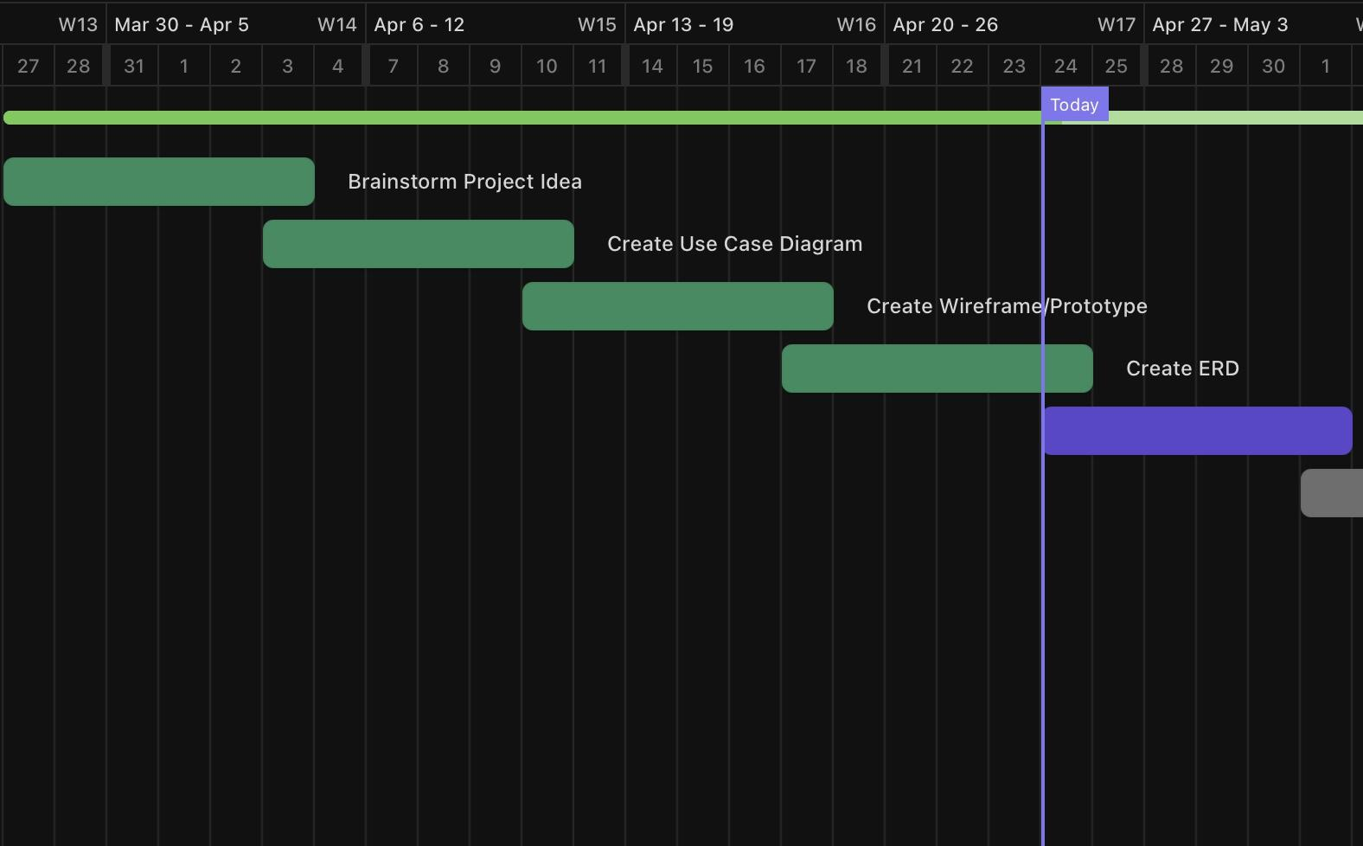
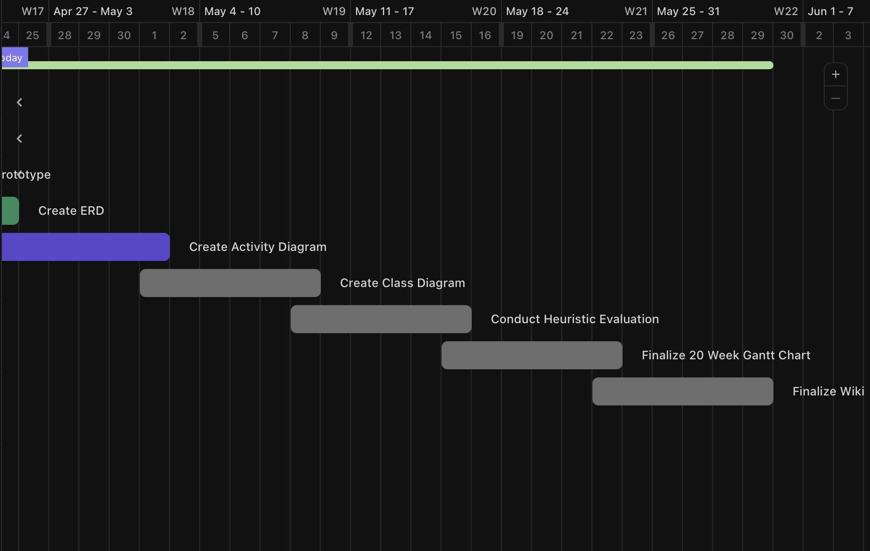
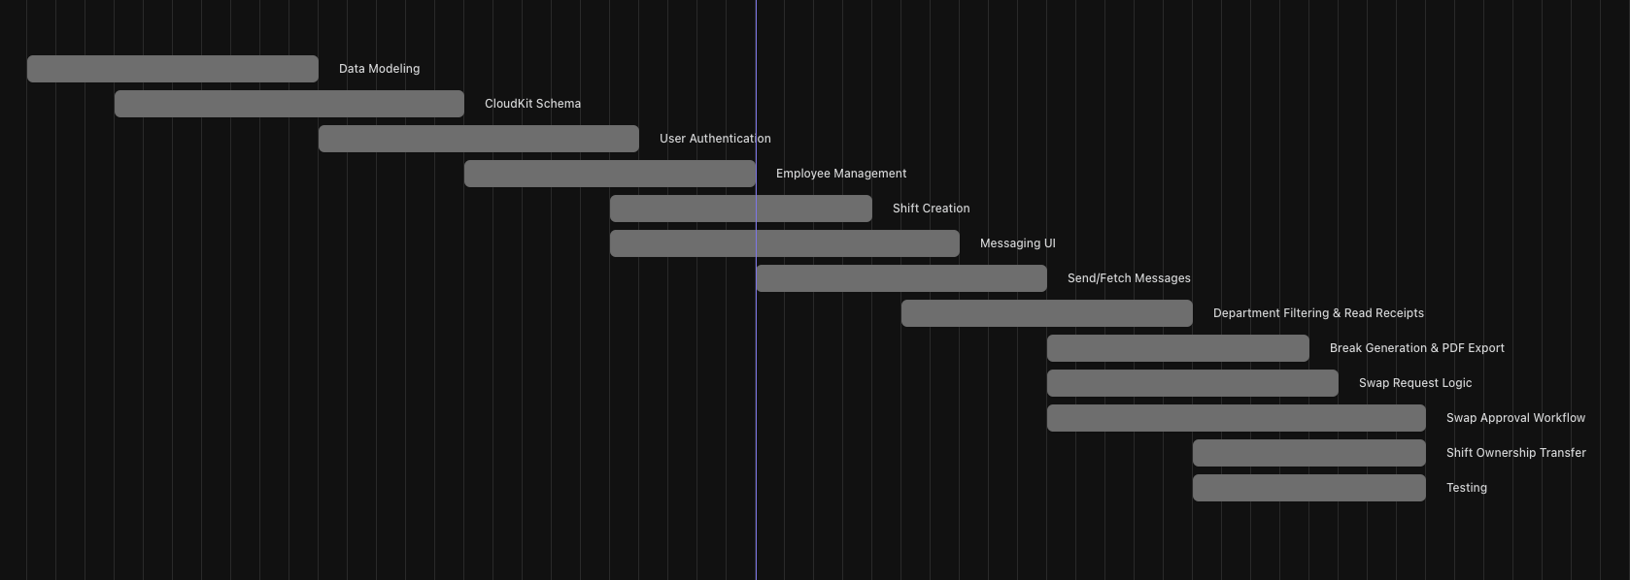
Gantt Chart

Slide 6
Timeline (Planning Phase)
Week 1: Brainstorm project idea
Week 2: Create Use Case Diagram
Week 3: Create Wireframe / Prototype
Week 4: Create ERD (Entity Relationship Diagram)
Week 5: Create Activity Diagram
Week 6: Create Class Diagram
Week 7: Conduct Heuristic Evaluation
Week 8: Finalize 20-Week Gantt Chart
Week 9: Finalize Wiki documentation
Week 10: Transition into coding phase

Slide 7
Timeline (Coding Phase)
Week 11: Data Modeling
Week 12: CloudKit Schema setup
Week 13: User Authentication
Week 14: Employee Management
Week 15: Shift Creation
Week 16: Messaging UI
Week 17: Send/Fetch Messages
Week 18: Department Filtering & Read Receipts
Week 19: Break Generation & PDF Export, Swap Request Logic
Week 20: Swap Approval Workflow, Shift Ownership Transfer, Final Testing

Slide 8
Changes From Last Quarter
Initial Plan (Last Quarter):
Simple app → only admin + basic user
View & edit schedules only
No roles, no swaps, no messaging
This Quarter:
Added role hierarchy (Director, ETL, TL, TM)
Built shift swap workflow (initiate → approve/deny)
Added in-app messaging for communication
Why Scope Changed:
Realized teams need flexibility & communication
Scheduling alone didn’t solve full problem

Slide 9
Database Organization
Users: login/authentication, roles
Employees: department, shifts
BreakSchedule: shift start/end, breaks, ownership
Messages: sender/receiver, content, timestamps
Moved from UUID → CKRecord.ID for stability
Notes:
CKRecord.ID is built in with apple

Slide 10
Obstacles Overcome
Past messages not saving in chat → fixed persistence issue
Shifts saving but not fetching → corrected CloudKit query predicates
Optional date handling in SwiftUI forms → redesigned input logic
Swap approvals → properly transfer ownership
Messaging subscriptions → trigger real-time notifications

Slide 11
Technical Design
AuthManager: Apple ID + username/password login/logout
CloudKitManager: save/fetch schedules, employees, users, messages
ScheduleViewModel: role-based filtering, state management
UI/UX: SwiftUI views for scheduling, swaps, messaging, PDF export

Slide 12
Live Demo

Slide 13
Questions?

